Slide 1
Functions and Transformations of Random Variables
Section 09

Slide 2
Transformation of continuous X
Suppose X is a continuous random variable with pdf $f_{X}(x)$ and cdf $F_{X}(x)$
Suppose $u(x)$ is a one-to-one function with inverse $v(x)$ ; so that $v\left(u\left(x\right)\right)=x$
The random variable $Y=u(X)$ is a transformation of X with pdf:
$f_{Y}\left(y\right)=f_{X}\left(v\left(y\right)\right)∗\left|v′(y)\right|$
If $u(x)$ is a strictly increasing function, then
$F_{Y}\left(y\right)=F_{X}(v\left(y\right))$ and then $f_{Y}\left(y\right)={F^{′}}_{Y}(y)$
Notes:
Do proof for Fy(y) = Fx(v(y))

Slide 3
Transformation of discrete X
Again, $Y=u(x)$
Since X is discrete, Y is also discrete with pdf
$g\left(y\right)=\sum_{y=u(x)}{f(x)}$
This is the sum of all the probabilities where u(x) is equal to a specified value of y

Slide 4
Transformation of jointly distributed X and Y
X and Y are jointly distributed with pdf $f(x,y)$
$u$ and $v$ are functions of x and y
This makes $U=u(X,Y)$ and $V=v(X,Y)$ also random variables with a joint distribution
In order to find the joint pdf of U and V, call it g(u,v), we expand the one variable case
Find inverse functions $h(u,v)$ and $k(u,v)$ so that $x=h(u\left(x,y\right),v\left(x,y\right))$ and $y=k(u\left(x,y\right),v\left(x,y\right))$
Then the joint pdf is:
$$g\left(u,v\right)=f\left(h\left(u,v\right),k\left(u,v\right)\right)∗\left|\frac{∂h}{∂u}∗\frac{∂k}{∂v}−\frac{∂h}{∂v}∗\frac{∂k}{∂u}\right|$$

Slide 5
Sum of random variables
If $Y=X_{1}+X_{2}$ then
$E\left(Y\right)=E\left(X_{1}\right)+E(X_{2})$
$Var\left(Y\right)=Var\left(X_{1}\right)+Var\left(X_{2}\right)+2Cov(X_{1},X_{2})$
If Xs are continuous with joint pdf $f(x_{1},x_{2})$
$f_{Y}\left(y\right)=\int_{−∞}^{∞}{f(x_{1},y−x_{1})}dx_{1}$
If Xs are discrete with joint pdf $f(x_{1},x_{2})$
$P\left[X_{1}+X_{2}=k\right]=\sum_{x_{1}=0}^{k}{f(x_{1},k−x_{1})}$

Slide 6
Convolution method for sums
If X1 and X2 are independent, we use the convolution method for both discrete & cont.
Discrete: $P[X_{1}+X_{2}=k]$
$=\sum_{x_{1}=0}^{k}{f_{1}\left(x_{1}\right)∗f_{2}(k−x_{1})}$
Continuous: $Y=X_{1}+X_{2}$
$\int_{−∞}^{∞}{f_{1}\left(x_{1}\right)∗f_{2}(y−x_{1})}dx_{1}$

Slide 7
Sums of random variables
If X1, X2, …, Xn are random variables and $Y=\sum_{i=1}^{n}{X_{i}}$
$E\left(Y\right)=\sum{E(X_{i})}$
$Var\left(Y\right)=\sum{Var(X_{i})}+2\sum_{i=1}^{n}{\sum_{j=i+1}^{n}{Cov(X_{i},X_{j})}}$
If Xs are mutually independent
$Var\left(Y\right)=\sum{Var(X_{i})}$
$M_{Y}\left(t\right)=\prod_{i=1}^{n}{M_{X_{i}}(t)}$

Slide 8
Central Limit Theorem
X1, X2, …, Xn are independent random variables with the same distribution of mean μ and standard deviation σ
$Y_{n}=X_{1}+X_{2}+…+X_{n}$
$E\left(Y_{n}\right)=nμ$
$Var\left(Y_{n}\right)=nσ^{2}$
As n increases, Yn approaches the normal distribution $N(nμ,nσ^{2})$
Questions asking about probabilities for large sums of independent random variables are often asking to use the normal approximation (integer correction sometimes necessary).

Slide 9
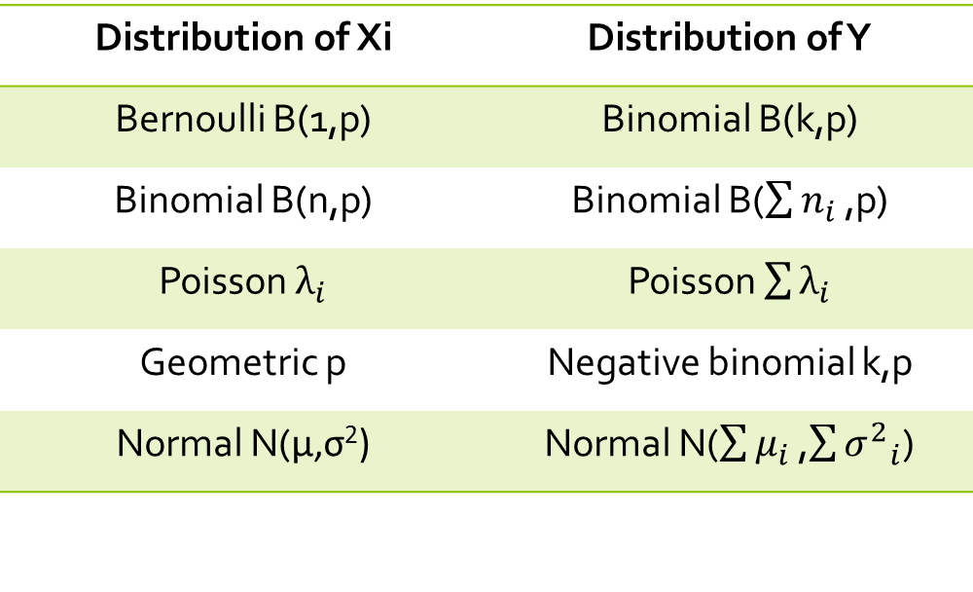
Sums of certain distribution
This table is on page 280 of the Actex manual
Distribution of Xi | Distribution of Y
Bernoulli B(1,p) | Binomial B(k,p)
Binomial B(n,p) | Binomial B($\sum{n_{i}}$ ,p)
Poisson $λ_{i}$ | Poisson $\sum{λ_{i}}$
Geometric p | Negative binomial k,p
Normal N(μ,σ²) | Normal N($\sum{μ_{i}}$ ,$\sum{{σ^{2}}_{i}}$)
There are more than these but these are the most common/easy to remember

Slide 10
Distribution of max or min of random variables
X1 and X2 are independent random variables
$U=max⁡\{X_{1},X_{2}\}$
$V=min⁡\{X_{1},X_{2}\}$
$F_{U}\left(u\right)=P\left[U≤u\right]=P\left[\max\left\{X_{1},X_{2}\right\}≤u\right]=P\left[\left(X_{1}≤u\right)∩\left(X_{2}≤u\right)\right]=F_{1}\left(u\right)∗F_{2}(u)$
$F_{v}\left(v\right)=P\left[V≤v\right]=1−P\left[V>v\right]=1−P\left[\min\left\{X_{1},X_{2}\right\}>v\right]=1−P\left[\left(X_{1}>v\right)∩\left(X_{2}>v\right)\right]=$ $1−\left[1−F_{1}\left(v\right)\right]∗[1−F_{2}\left(v\right)]$

Slide 11
Mixtures of Distributions
X1 and X2 are independent random variables
We can define a brand new random variable X as a mixture of these variables! X has the pdf $f\left(x\right)=a∗f_{1}\left(x\right)+\left(1−a\right)∗f_{2}(x)$
Expectations, probabilities, and moments follow this “weighted-average” form
$E\left(X\right)=aE\left(X_{1}\right)+\left(1−a\right)E(X_{2})$
$F_{X}\left(x\right)=aF_{1}\left(x\right)+(1−a)F_{2}(x)$
$M_{x}\left(t\right)=aM_{X_{1}}\left(t\right)+(1−a)M_{X_{2}}(t)$
Be careful! Variances do not follow weighted-average! Instead, find first and second moments of X and subtract
Notes:
special case x1=0
also x =/= ax1 + ax2

Slide 12
Sample Exam #95
X and Y are independent random variables with common moment generating function
M(t) = exp((t^2) / 2).
Let W = X + Y and Z = Y-X.
Determine the joint moment generating function, M(t1, t2) of W and Z.

Slide 13
Sample Exam #98
Let X1, X2, X3 be a random sample from a discrete distribution with probability function
p(x) = 1/3, x = 0
2/3, x = 1
0, otherwise.
Determine the moment generating function, M(t), of Y = X1 * X2 * X3.

Slide 14
Sample Exam #102
A company has two electric generators. The time until failure for each generator follows an exponential distribution with mean 10. The company will begin using the second generator immediately after the first one fails.
What is the variance of the total time that the generators produce electricity?

Slide 15
Let x be uniformly distributed on the range [10, 100].
Y = 3*e^(3x)
Find f(y) ,the probability density function of Y.
Use f(y) to find the expected value of Y.

Slide 16
Let f(x,y) = (x+y)/8 for 0<x<2 and 0<y<2
U = 2x + 3y and V = (x+y)/2
Find f(u, v), the joint probability density function of U and V.

Slide 17
Sample Exam #289
For a certain insurance company, 10% of its policies are Type A, 50% are Type B, and 40% are Type C.
The annual number of claims for an individual Type A, Type B, and Type C policy follows Poisson distributions with respective means 1, 2, and 10.
Let X represent the annual number of claims of a randomly selected policy.
Calculate the variance of X.

Slide 18
Sample Exam #296
A homeowners insurance policy covers losses due to theft, with a deductible of 3. Theft losses are uniformly distributed on [0,10].
Determine the moment generating function, M(t), for t =/= 0, of the claim payment on a theft.

