Slide 1
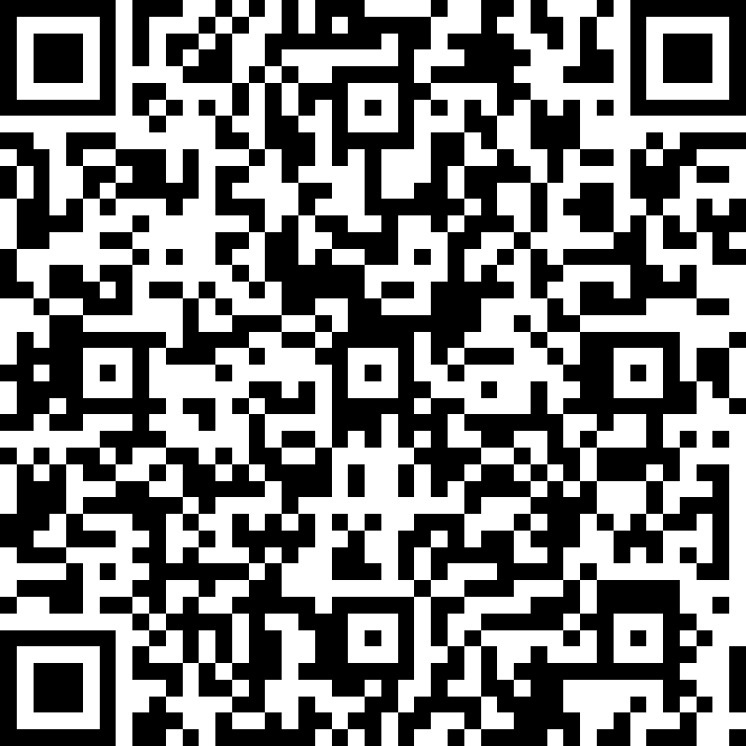
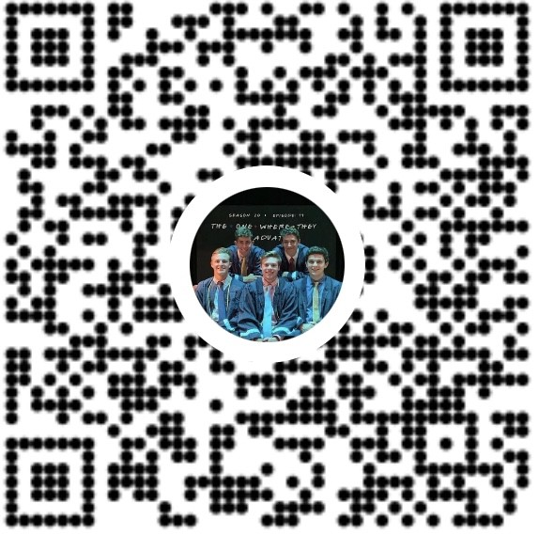
Actuarial Science Major Forum
While you wait…
Scan the QR Code below to register your attendance and sign up for our weekly email:
Pay club dues:
$20 Venmo (@JP-Grattan or scan QR Code below), include name and PSU ID (abc1234), or pay with cash (see J.P. Grattan)
Attendance QR Code
Venmo:
@…
Name and PSU ID (abc1234) in memo
Cash:
See J.P. Grattan
7:00 PM – 8:30 PM
Thursday August 26, 2021
102 Thomas

Slide 2
Agenda
Introduction to Actuarial Science and PSU’s program
What’s being an actuarial science student at PSU all about?
Academics
Exams
Career
Community
PSU Actuarial Science Club upcoming events and programs
Questions

Slide 3
Majoring in Actuarial Science
Great Major!
# 1 Job in US (per CNBC)
# 1 School for Recruiters (per WSJ) and #2 in producing CEOs per CNBC
One of the largest Actuarial Program in US
About 150 exam passers per year
About half from Smeal, half from Eberly (Math & Stat)
Center of Actuarial Excellence – only 17 in US
But It’s Difficult
Challenging exams required to become a credentialed actuary
1+ internship, 2+ exams, >3.2 GPA in college to get a job
Students with As and high Bs in Calculus and Probability: pass exams, get jobs

Slide 4
Faculty
Steve Putterman, FSA
SVP at Prudential and VP at Sun Life, Aetna, and Phoenix - Insurance and Annuity Divisions
Teaches RM 410 (Financial Math) & RM 214 (Probability) & RM 494H (Honors Course) in Fall/Spring
Zhongyi Yuan, PhD & ASA
Teaches RM 412 (Pricing Life Insurance) in Fall
Teaches RM 420 (STAM Exam: P&C Insurance)in Spring
Nan Zhu, PhD & FSA
Teaches RM 415 (Pricing Derivatives) in Spring/Fall
Teaches RM 411 (Pricing Life Insurance) in Spring
Amanda Hammell, FSA
Taught RM 412 (Pricing Life Insurance) in Fall 2020
New Head of Actuarial Program starting Spring 2022!
Lisa Posey, PhD/ Dave Cather, PhD
Teach Insurance and Risk Management

Slide 5
The Good We Do for the World
Needing an expensive medical operation
Your kid’s financial needs if you or your spouse die early
Becoming disabled
Needing a new car (or health care) after a collision
Your home burning down, or flooded by a hurricane
Outliving your assets in retirement
Getting sued

Slide 6
Where Do Actuaries Work?
Industry
Practice Area
Insurance
Rotational programs
Competitive study programs
Clear reporting structure (one boss)
Reasonable hours
Consulting, Investment, Accounting Firms
Dynamic work environment
Longer hours during busy season
Government & Academia
Large companies, unions, churches, non-profits
Life/Annuities
Health
Retirement
Property/Casualty
Reinsurance
Finance/Investment

Slide 7
Club Officers
Officer | Position
Lucas Richardsen | President
Danny Berlin | Vice President
Taylor Geppert | Director of Corporate Outreach
Max Cohen | Assistant Director of Corporate Outreach
Bella Santori | Assistant Director of Corporate Outreach
J.P. Grattan | Director of Finance
Hailey Johnson | Director of Communications
Nevin Kara | Assistant Director of Communications
Erin Studdert | Director of Student Engagement
Jack Berry | Assistant Director of Student Engagement
Shaney Chang | International/Commonwealth Student Liaison
Brady Painter | Director of Technical Workshops & Databases
Eric Geesaman | Assistant Director of Technical Workshops & Databases
Dustin Bauer | Website Director
*Feel free to email officers in addition to your mentor - contact information on psuactsci.com*

Slide 8
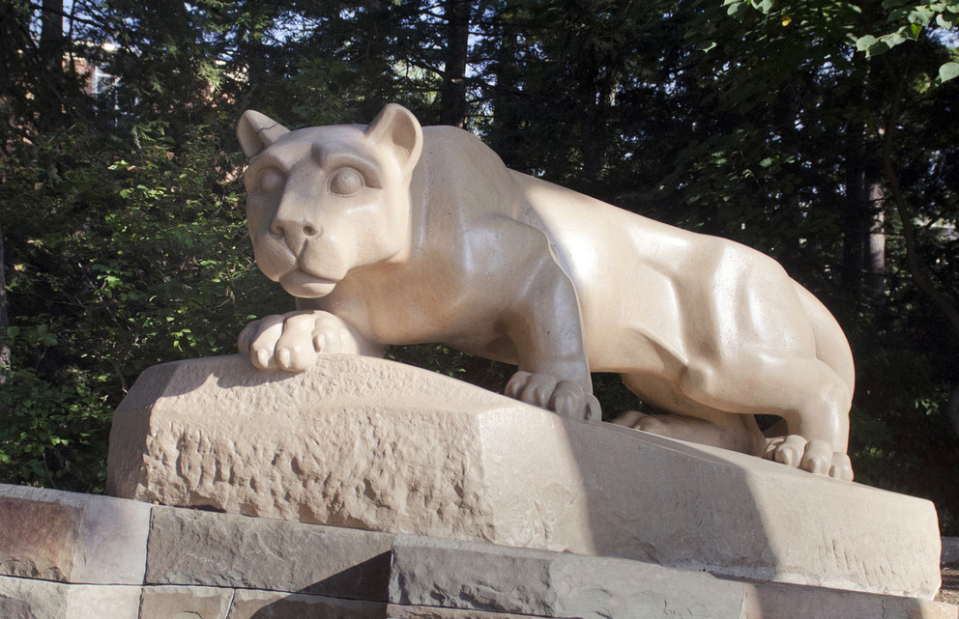
Keys to Success as an Actuarial Student at PSU:
Academics
Exams
Career
Community

Slide 9
Majoring in Actuarial Science at PSU
Three ways to major in Actuarial Science:
Smeal - Actuarial Science
Eberly - Mathematics (Actuarial Option)
Eberly - Statistics (Actuarial Option)
Personal preference, all three include core actuarial courses
Smeal: official home of the program, more business courses
Mathematics: more upper level, theoretical math courses
Statistics: more coding and statistics courses

Slide 10
Examples of Major Specific Courses
Smeal/Actuarial Science
MGMT 301 – Management
MKTG 301 – Marketing
Math
MATH 220 – Matrices
MATH 311W – Discrete Math
Stat
STAT 380 – Data Science
STAT 461 – Analysis of Variance

Slide 11
Core Actuarial Courses
RM 214: Intro to Probability (Exam P/1)
RM 410: Financial Mathematics (Exam FM/2)
RM 415: Investments and Financial Markets (Exam IFM/3)
RM 411/RM 412: Life Contingencies (Exam LTAM)
RM 420: Health and Property and Casualty (Exam STAM)

Slide 12
Resources to Help You Pick the Right Major & Courses
PSU Advisors
Online Resources
PSU Bulletins
Actuarial Science Club Website – Scheduling Page, Schedule Tool
Actuarial Science Club Mentor
Actuarial Science Club Schedule Event & Review Sessions

Slide 13
Keys to Success as an Actuarial Student at PSU:
Academics
Exams
Career
Community

Slide 14
Actuarial Exams Overview
Exam topics: math (probability, financial), investments/financial markets, insurance products, regulation
Two organizations give actuarial exams in US, choose exam path based on industry
SOA (Society of Actuaries): Life, Health, Pensions, Finance, ERM
ASA (Associate of Society of Actuaries), FSA (Fellow of Society of Actuaries)
CAS (Casualty Actuarial Society) : Property/Casualty (Home, Auto, etc.)
ACAS (Associate of Casualty Actuarial Society), FCAS (Fellow of Casualty Actuarial Society)
Preliminary exams given via CBT (computer-based testing) centers across the country
The first two exams are the same for both tracks, so you have some time to choose path

Slide 15
Why Take Actuarial Exams?
Help you get summer internships, required for full-time jobs
1+ exams recommended for summer internship
2+ exams recommended for full-time job
Becoming a certified actuary (ASA/FSA or ACAS/FCAS) demonstrates your actuarial qualifications to employers

Slide 16
Validation by Educational Experience (VEE)
VEE = Courses offered at PSU required by SOA, CAS, and Employers
Courses required to graduate:
VEE Economics: ECON 102, ECON 104
VEE Corporate Finance: ACCTG 211, FIN 301
VEE STAT 415 (Mathematical Statistics)
Must receive a grade of B- or better for VEE credit
Or 4 or 5 on AP tests
Can also get credit by exam through
ACTEX for Finance & Applied Stat VEE’s
CLEP for Econ VEE

Slide 17
Resources to Help You Learn About & Pass Exams
Passing Exams:
PSU Actuarial Courses
RM 214, RM 410, RM 415, RM 411/412
Study Manuals
Coaching Actuaries, The Infinite Actuary, ACTEX
Club and Department Reimbursements
Submit online reimbursement form when you pass an exam to receive partial reimbursement for exam fees
Discounts on study materials via Club
Learning More:
Online
PSU Actuarial Science Club Website – Exams Page
SOA, CAS websites
Coaching Actuaries, The Infinite Actuary, ACTEX websites
Actuarial Science Club Mentor

Slide 18
Guidance on SOA Exam Path Changes
Overview of Changes – Full Details on SOA website (here)
IFM eliminated after Nov. 2022
LTAM and STAM split into FAM (fundamentals) and ALTAM or ASTAM after June 2022
New ATPA (advanced predictive analytics) exam starting June 2022
2 new Foundations modules, FAP reduced to 5 modules starting Jan 2025
Recommended Course of Action
Take IFM if enrolled in RM 415 in FA21 or SP22, passing IFM exempts you from ATPA
More to follow

Slide 21
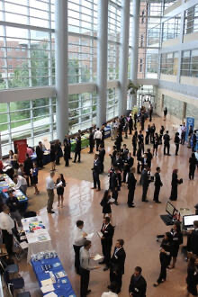
Keys to Success as an Actuarial Student at PSU:
Academics
Exams
Career
Community

Slide 22
Internships and Jobs
Goals:
One or more summer actuarial internships
Accept a full time actuarial job offer before you graduate
What employers are looking for:
>3.2 GPA
1+ exam for internship, 2+ exams for job
Technical and soft skills
Extracurricular engagement and leadership experiences

Slide 23
Resources to Get an Internship/Job
Actuarial Science Club Career Fair
Club Resume Book
Actuarial Science Club Boot Camp
Other Resources
Club Events: Professionalism Workshop, Resume Reviews
Club Website
Club Mentor

Slide 24
Actuarial Science Club Career Fair
Monday 9/13/21 from 5 to 8 PM through virtual platform Brazen (instructions will be on the club website)
Historically over 30 companies
Great place to find Internships and Full Time Jobs
1st yr students can get internships if have exam or very good in Math
Check Nittany Lion Careers
Some firms don't attend Career Fairs
Apply on their websites
Information Sessions
Check club website for dates

Slide 25
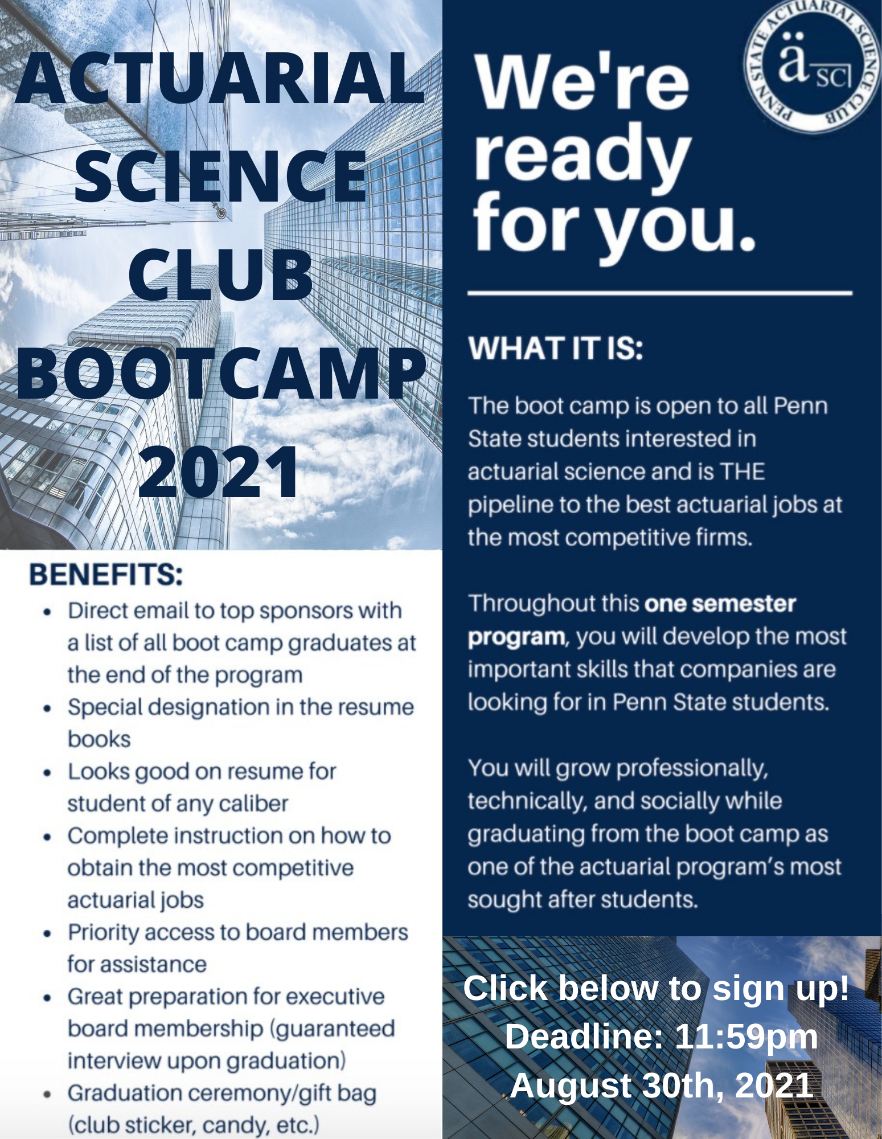
Actuarial Science Club Boot Camp
Pipeline to getting internships and jobs
Recognition in resume book
Great experience
Free 30-day subscription to GOAL
Anyone who did not participate last year can apply
Kick-off event 8/31 7:30pm

Slide 26
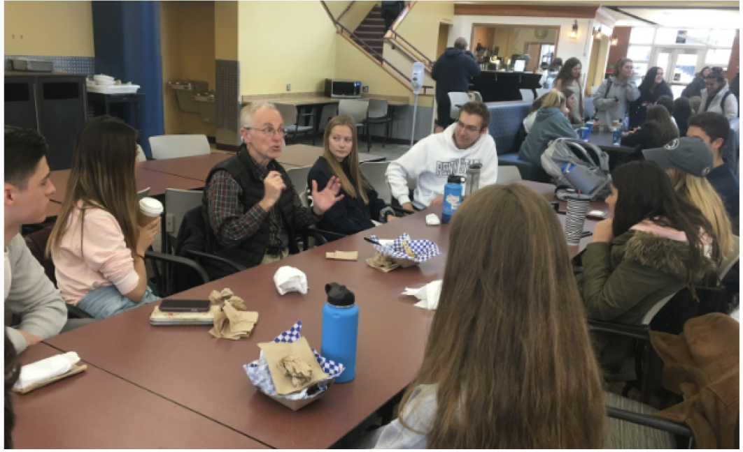
Keys to Success as an Actuarial Student at PSU:
Academics
Exams
Career
Community

Slide 27
Mentorship Program
Opportunity to meet and learn from older students
Get advice on:
Resumes
Career Fair
Interviews
Exams/Schedule Planning
Sign up to be a mentor/mentee on our club website!!
(under the resources tab)

Slide 28
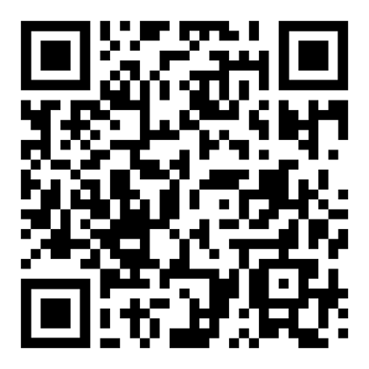
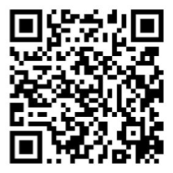
Meeting Other Students in the Major
RM Classes
Club Events
Club and Class-Specific GroupMe:
Freshmen Group Chat
Group Chat

Slide 29
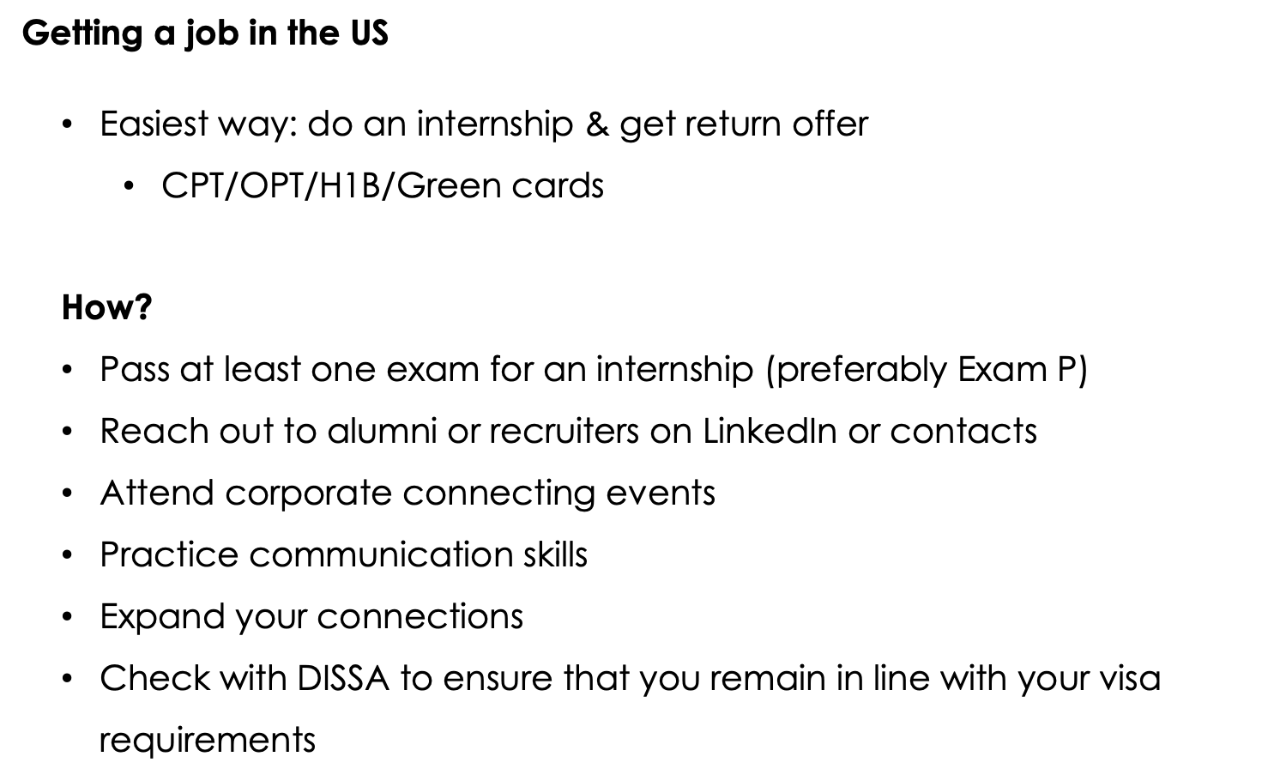
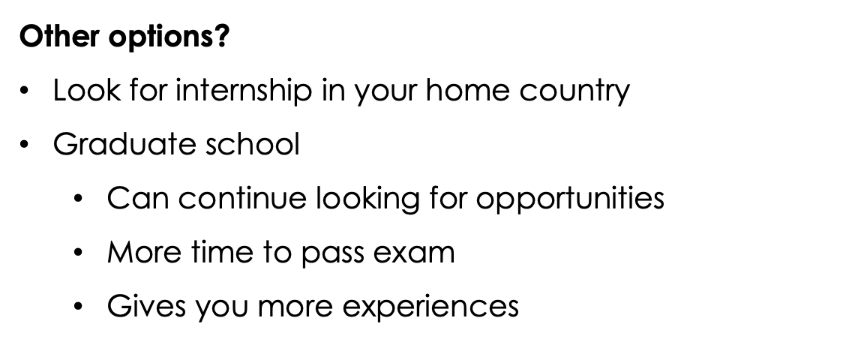
International/Commonwealth Students

Slide 30
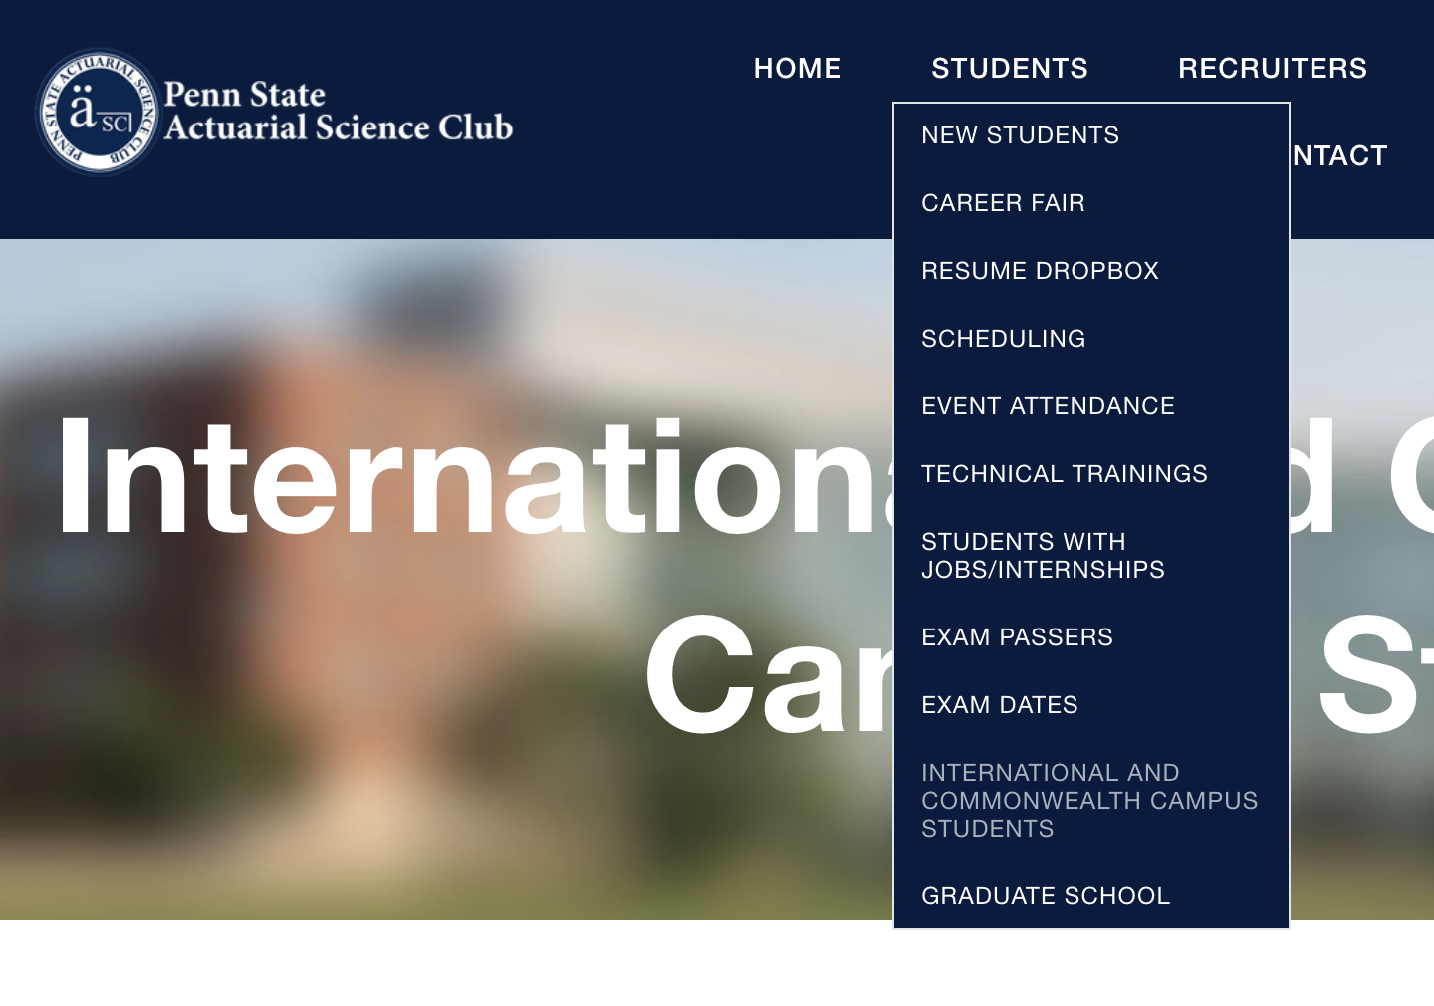
Resources for International Students

Slide 31
Upcoming Club Events and Programs
Actuarial Science Club Career Fair (9/13, Virtual Platform, 5-8pm)
Actuarial Science Club Boot Camp (8/30 Application Deadline)
SOA President Roy Goldman (9/23 6-7pm)
Freshman Orientation (8/31 7-7:30pm)
International Student Meet & Greet (9/3 6pm)
Professionalism Workshop (9/1 7-8pm)
Resume Review Sessions (9/2 and 9/9 7:30-9pm)
Professional Headshots (9/2 3-6pm)
*Merch Order Form: Next week's email

Slide 32
Website Demo
www.psuactsci.com

Slide 33
Questions?
Thanks for coming!

