Slide 2
Professionalism and the Aspiring Actuary
Tom Wildsmith, 2015-16 Academy President The Pennsylvania State University Oct. 6, 2016

Slide 3
What Actuaries Do Matters
Actuarial work has significant societal consequences. Virtually every American’s life is affected by actuarial work:
Retirement security.
Health care.
Property.
Solvency and financial risk.
Notes:
Retirement security (Social Security, public and private pensions, lifetime income products).
Health care (private health insurance, Medicare and Medicaid, long-term care insurance).

Slide 4
Who Depends on Actuarial Analysis?
Audiences who depend on actuarial analysis:
The public.
Elected officials.
Regulators.
System and program administrators.
Insurers and other employers.
Notes:
The public (e.g., beneficiaries, claimants, consumers)
Elected officials (design policy to achieve objectives)
Regulators (ensure appropriate, effective regulation)
System and program administrators (e.g., pension plans)
Insurers and other employers

Slide 5
Audiences of Actuarial Analysis: Example
Statements of Actuarial Opinion (SAOs) for the annual Medicare and Social Security Trustees Reports include the affirmation:
“I am a member of the American Academy of Actuaries and I meet the Qualification Standards of the American Academy of Actuaries to render the actuarial opinion contained herein.”

Slide 6
What Does It Mean to Be a Professional?
You’re working hard to become a professional actuary – what does that mean?
What makes an actuary a professional whose expert advice on financial security can be relied on is not just knowledge of or training in a subject matter, but also the responsibilities he or she assumes and applies in recognition of the greater consequences of his or her work, i.e., his or her professionalism.

Slide 7
The Academy
The goal of maintaining and promoting actuarial professionalism is integral to why the Academy was founded 50 years ago.
The Academy’s membership today is approaching 19,000 individual actuaries.

Slide 8
The Academy
“The millions of people involved and the immense size of the assets of our life insurance companies and pension funds dictate protection from any possibility of unsound actuarial principles.”
—Academy Founding President Henry Rood (1965-66)

Slide 9
The Academy
Video introduction to the Academy—click the arrow.

Slide 10
The Academy
The Academy is the national association for actuaries practicing in the United States.
It provides a single, inclusive national body for the profession that represents qualified actuaries of all specialties.

Slide 11
Academy Mission
The Academy has a dual mission: “The Academy assists public policymakers on all levels by providing leadership, objective expertise, and actuarial advice on risk and financial security issues. The Academy also sets qualification, practice, and professionalism standards for actuaries credentialed by one or more of the five U.S.-based actuarial organizations in the United States.”
Notes:
The two primary parts of the Academy’s mission are inextricably linked.

Slide 12
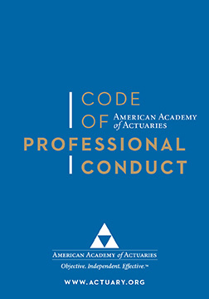
The Specific Meaning of Actuary as Professional in the U.S.
“The Code of Professional Conduct sets forth what it means for an actuary to act as a professional. It identifies the responsibilities that actuaries have to the public, to their clients and employers, and to the actuarial profession.” The Code was adopted individually by the five U.S.-based actuarial organizations.

Slide 13
Professionalism and the Academy
Click arrow to play video.

Slide 14
Professionalism and the Academy
The Academy:
Provides the code of conduct;
Establishes the qualification standards and standards of practice;
Houses the disciplinary process; and
Is the primary voice for the profession to legislators, regulators, and the public.

Slide 15
Professionalism and the Academy
Code of Professional Conduct.
U.S. Qualification Standards, including continuing education (Committee on Qualifications).
ASOPs, promulgated by the Actuarial Standards Board (ASB).
Actuarial Board for Counseling and Discipline (ABCD).
Council on Professionalism (discussion papers, applicability guidelines, seminars, webinars).
Notes:
ASB:
Establishes Actuarial Standards of Practice (ASOPs) to govern practice in the U.S.
The ASB is an autonomous entity within the Academy.
The sole discretion to promulgate ASOPs for practice in the U.S. is vested in its nine members.
ABCD:
The ABCD is an autonomous entity within the Academy.
It evaluates alleged violations of the standards of conduct.
It recommends disciplinary action to participating organizations (all the U.S.-based actuarial organizations participate).
The ABCD is also available to respond to actuaries’ requests for guidance on professional issues. The ability to ask for guidance, confidentially, from experienced practitioners is a very important element to help newer actuaries especially.

Slide 16
Qualification
What’s the goal of qualification?
Ensure that practicing actuaries are competent to perform the services they provide to their employers and clients.
Unqualified practice has consequences for:
Employers.
Clients
Public.

Slide 17
Qualification
Qualification requires:
A minimum level of technical skill.
Practical real-world experience.
Familiarity with all the laws, regulations and standards of practice that apply.
Keeping up with new techniques, rules and market developments.
Notes:
The US qualification standards speak to each piece.

Slide 18
Qualification
Basic education may be provided by education providers who operate either globally or in the U.S., but the Academy is responsible for determining what it takes to practice in the U.S.

Slide 19
ABCD Disciplinary Process
Fact-finding, not an adversarial forum
Whether or not actuary materially violated the Code of Professional Conduct
Recommends discipline, when appropriate, to membership organization
Membership organizations determine whether to impose discipline according to their own procedures

Slide 20
What Differentiates Actuaries
So why are actuaries different?
Notes:
What separates actuaries from health economists or financial analysts is not that we have some fundamentally different kind of mathematics, but that we are part of a self-regulating profession, with all that entails. That’s why state insurance commissioners require insurance company financial statements to be signed by an actuary, and not by a consulting mathematician.

Slide 21
Professionalism
Discussion Point: What sorts of responsibility do you think someone might expect an actuary to demonstrate?
Integrity, honesty, adherence to the law.
Satisfy applicable professional standards.
Rendering service only when qualified to do the work.
Notes:
These and other responsibilities are spelled out in the Code of Professional Conduct.

Slide 22
The Academy Provides
Access to resources and support in maintaining a high level of professionalism and staying current on relevant public policy issues that affect the actuarial profession, such as:
Quarterly webinars addressing current, relevant professionalism topics + archived library of professionalism and public policy webinars.
Public policy webinars addressing practice-specific developments and issues.
USQS Attestation Form.
Actuarial eLearning Center.

Slide 23
The Academy Provides
Professionalism discussion papers.
ASOP Applicability Guidelines.
Contingencies: “Up to Code” (written by ABCD members).
Actuarial Update: “Professionalism Counts.”
Effective ABCD guidance and disciplinary regime.

Slide 24
Actuarial Professionalism: A Foundation for Trust
Our standards and disciplinary process are necessary to assure the public that we can, as a profession, be trusted. They are why the Academy was created, and are necessary for U.S. actuaries to be recognized as a self-regulated profession.

Slide 25
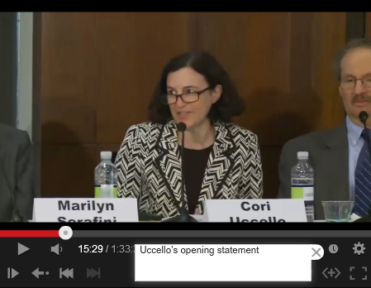
Academy Public Policy Work
Notes:
Hill Briefings, the Health Practice Council’s Hill visits, comment letters and Congressional testimony

Slide 26
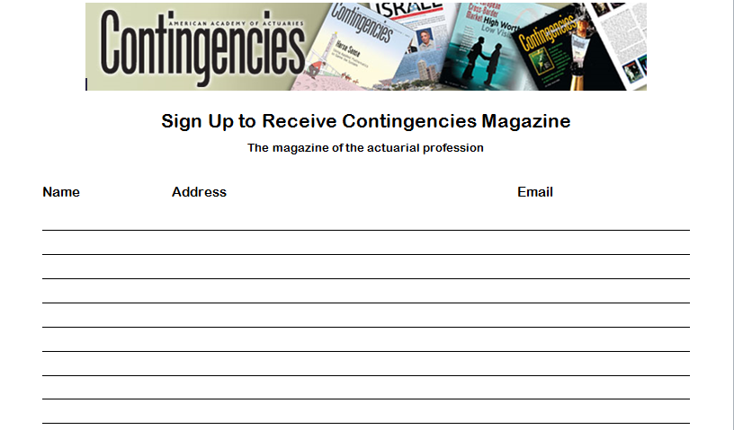
For Students – Public Policy Issues
Contingencies is a highly accessible magazine (issued 6 times a year) for the general public on many issues related to or influenced by actuarial work.
It’s a way to familiarize yourself with policy issues and how actuaries are involved.
If you would like a digital subscription, please sign up.

Slide 27
When Can You Join the Academy?
After you meet the basic education requirements (e.g., ASA, ACAS)
Willingness to abide by professional requirements (e.g., Code, Qualification Standards, ASOPs).
Good moral character and professional integrity.

Slide 28
Why Should You Join the Academy (When Eligible)
The Academy is the national association for all actuaries practicing in the U.S.
It establishes all U.S.-specific requirements and obligations to be qualified to practice in the U.S.
Membership demonstrates your commitment to and support of professional practice and public policy participation of the profession.

Slide 29
Thank You
Questions?

