Slide 1
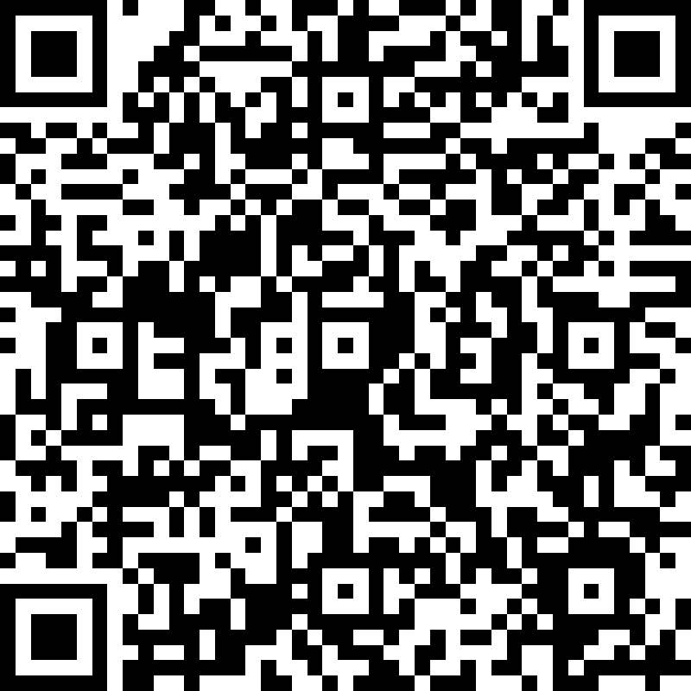
Professionalism & Interviewing
How to Prepare For Info Sessions, the Career Fair, and Interviews

Slide 2
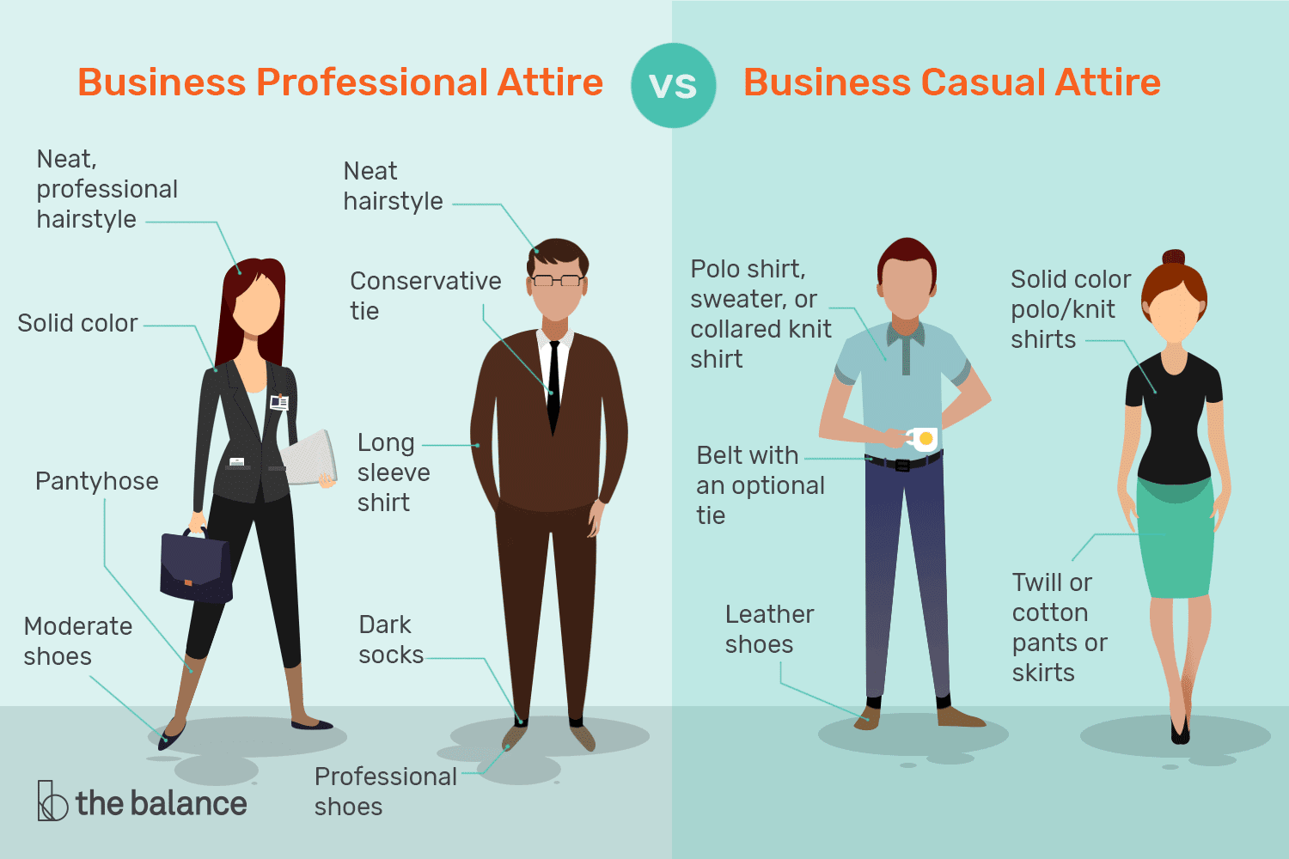
Professionalism
Business Professional (Career Fair)
Business Casual (Info Sessions)
Handshake or Elbow Bump
Eye contact
Formal, positive tone

Slide 3
Resume
Be as specific as possible
Always quantify when possible
Make sure the resume looks clean and there are no grammatical or format errors
Cater your experiences to fit the descriptions and qualifications of a particular position
Ask a friend/peer/mentor to look over your resume
Checkout the club website for example resumes

Slide 4
Application Process
Step 1: Online Application
Step 2: Recorded Interview
Step 3: Live Interview

Slide 5
Preparing For Interviews
Review your resume
Research the company
Practice behavioral and technical interview questions
Prepare a list of questions

Slide 6
Example Questions To Ask
What are the main objectives and responsibilities of this position?
What is the company culture like?
What are the critical issues/objectives facing the
department/company?
How has the pandemic affected the work for this role?
How does this position or my role, contribute to the
company accomplishing their goals and objectives?
Is there any particular skill you feel is critical to success?
Why did you join this company? What has kept you here?
Is the company work mode primarily in-person, hybrid, or remote?

Slide 7
During the Interview
Understand each question before asking
Emphasize what YOU did
Listen for opportunities to promote yourself
Use a positive tone
Be aware of your body movements, hand gestures, and eye contact

Slide 8
Virtual Interviews
Some interviews this semester may be done virtually
Zoom, HireVue, Skype, etc.
Dress and act the same as an in person interview
Look at the camera when speaking
Test microphone and speaker before the interview
Distractions may happen, that is OKAY!
Try to find a quiet spot where you can speak freely

Slide 9
Example Interview Questions
Tell me about yourself.
Describe a time you overcame a challenge.
Tell me about at time you worked with a team.
What are your strengths?
What are your areas for development?
Tell me about a time you improved a process.

Slide 10
STARR Method - How To Stand Out
S = Situation: Describe what you were facing
T = Target: Describe what you wanted to achieve
A = Action: Describe what you did
R = Result: Describe what happened and how things turned out
R = Reflection: Describe what you learned and what you would do differently if presented the same circumstances

Slide 11
Info Sessions
Go to as many as possible – 20+ are scheduled for this year
Always try to ask questions about the presentation
Take notes
Slide Decks may be available on club calendar afterwards
Try to talk with one of the recruiters 1 on 1 afterward
You can give them a copy of your resume
Full list of info sessions on club website

Slide 12
Career Fair
September 12th, 5-8PM in Smeal Atrium
About 30 companies
Prepare elevator speech
Bring 10+ printed out copies of resume
Stop by as many companies as you would like
Helpful to decide which companies before so that you can prepare
Apply to companies online

Slide 13
Opportunities for Underclassmen
Prudential ASAP Externship Program
Aon Actuarial Career Discovery Program
Aetna/CVS Health Blue Bell College Day

Slide 14
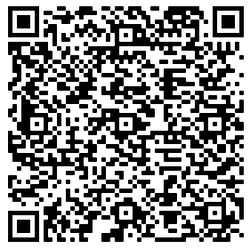
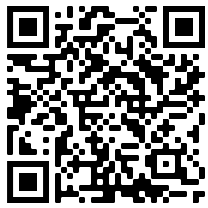
P&C at Penn State
Still exploring? Join our PSU CAS Peer Group on Teams!
Interested in P&C? Sign up for CAS Student Central!

Slide 15
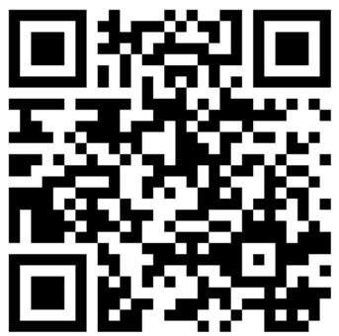
P&C Professional Opportunities
Visit Erie, Guy Carpenter, Munich Re, EY, Deloitte, and Mutual Benefit Group at the career fair!
P&C Night in Late October
Jrs. And Srs.: Apply to Zurich NA's Internship ->
Next year: rising sophomores can complete the Munich Re Externship to learn about the P&C industry

Slide 16
Other Club Opportunities
Resume Reviews and Mock Interviews with Mentors
Schedule via Microsoft Bookings on club website
Boot Camp
TIA Technical Skills Course and Technical Workshops
Reach out to club leadership with any questions!

Slide 17
Questions?

