Slide 1
Intro to VBA
Originally by Andrew Waldron abw5082@gmail.com
Revised 5/27/2016

Slide 2
Developer Tab/Ribbon
Windows (Office 2007/2010)
If no VBA, File>Options>Add-Ins: Select VBA
File -> Options -> Customize Ribbon
Check the box that says Developer
Click OK
Mac (Office 2011)
Click the button that looks like a gear at the right end of the ribbon
Choose Ribbon Preferences…
Check the Box that says Developer
Click OK

Slide 3
Using the Visual Basic Editor
Two ways to get there from excel
Alt + f11
Windows: Developer Tab -> Visual Basic
Mac: Developer Tab -> Editor
The Project has 2 parts per workbook
Excel Objects (your worksheets)
Modules
Write code on right hand side.
Run your program often while programming to check it
Project is the left sidebar as shown on next slide
Should automatically be open
If not, View -> Project Explorer
Best way to learn VBA: look at someone else’s program! ☺
Then do your own programing

Slide 4
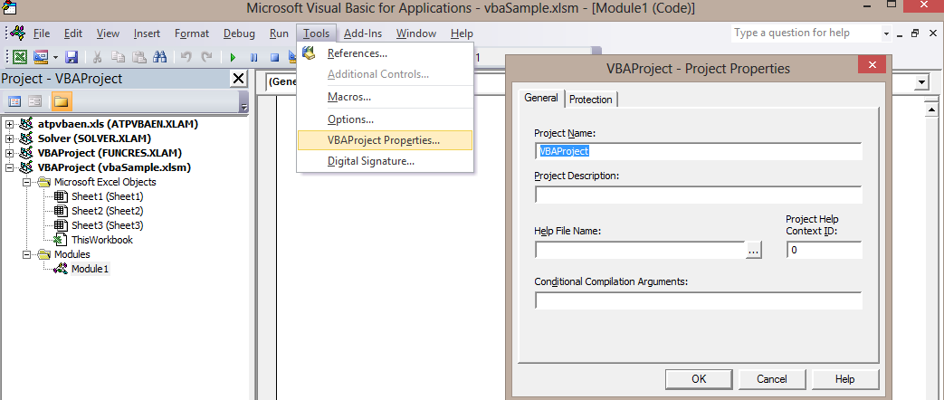
Using the Visual Basic Editor
Recommendations
Name your project and give it a description
Tools -> VBAProject Properties…

Slide 5
Using the Visual Basic Editor
Only have ONE excel workbook open
Project Explorer will show all open workbooks
Save your files as macro-enabled workbook .xlsm
You could lose your code, if you don’t
Do calculations in Excel before writing a VBA program to do it
Put all your helpful Functions in one module, call it TookKit, and start all your programs with it as base.

Slide 6
Using the Visual Basic Editor
We are going to focus on using modules
If you do not see any modules insert one
If you decide to delete it, you probably don’t want to export it, so say no to question in dialogue box

Slide 7
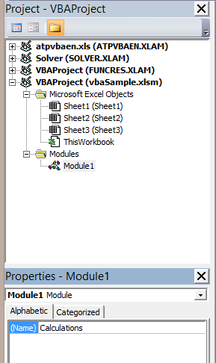
Using the Visual Basic Editor
Recommendations
Name your modules
From the properties window change the (name) property
View -> Properties Window or f4

Slide 8
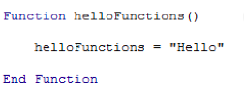
Creating Macros
Subs
Runs a series of commands
Returns nothing
Linked to buttons or shapes
Runs when you click button
Most times we’ll use a sub
Functions
Runs a series of commands
Returns a value
Can be used in VBA Function
& Excel cells
Runs when typed in a cell
Example where used in a cell:
= Sumtwo(A1, A2)
‘Sumtwo is a function as it returns sum
Notes:
Show how to run these in excel

Slide 9
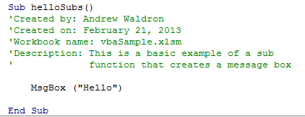
Creating Macros
Comments help others understand your coding
Use a single quote (‘)
‘Comments appear in green
VBA ignores comments
When use?
For each sub/function
comment your name
when created
Describe program
workbook name
Frequently describe what’s happening
Can also be used to prevent a line from running

Slide 10
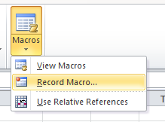
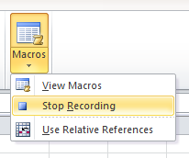
Record keystrokes & mouse clicks in macro
Creates VBA code for everything you do
Good way to program if you don’t know VBA functions like copy, paste, etc.
On the Developer tab
Click Record Macro
Stop recording when done
From Developer tab
Run often when programming to check for errors

Slide 11
How to Run a Macro
From the VB Editor
click inside the sub and then click play button or f5
From Excel (or Developer Tab’s Insert >Form)
Create a shape
Right click -> assign macro
Give it the name of a program that already exists, or create name and program it

Slide 12
VBA Variables
Type the following to tell VBA about your variables
Dim VarName As Type
Create your variables at beginning of your code
Example
Sub Name ()
‘Dim variables
‘Read in data or obtain thru input box
‘Code that manipulates variables
‘You must tell PC order of calculations, step by step
‘You don’t need to print everything, as in Excel
‘Print out the variables or display in message box
End sub

Slide 13
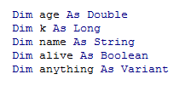
VBA Variables
Dim varName As Type
Common Types:
Double – decimals
Long – integers
String – letters
Boolean – true/false
Variant – anything

Slide 14
VBA Variables
DIM helps program use less memory & run faster
Otherwise, Variant is default, which takes more space
Can Dim Function and inputs too
Function AnnPV(InterestRate As Double, N As Integer) As Double
Type Option Explicit at very top before Sub or Function
Requires that all variables be in a Dim statement
Prevents mistakes like misspelling
If misspell a variable, VBA uses value of 0 and not catch it
Won’t catch if use duplicate names of functions/variables

Slide 15
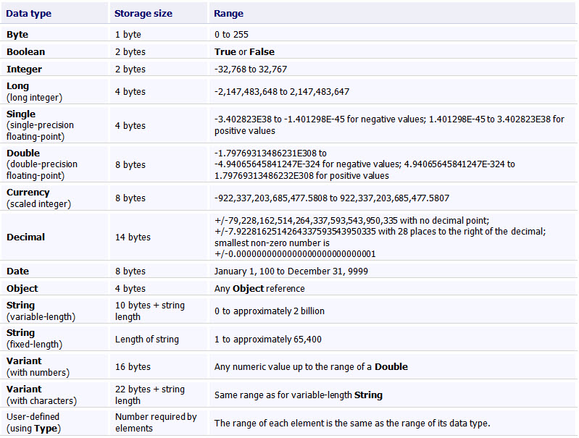
VBA Variables - Data Types

Slide 16
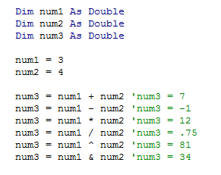
Mathematical Operators
Just like in Excel: ( ) ^ * / + - &
Do calculations to right of the equal sign
A = A+2 is ok. It bumps up A by 2. Good for loops.
Comments show what operator will do- it will work without the comments
I declared 3 variables
I gave 2 of them values
I used operators to give num3 a value

Slide 17
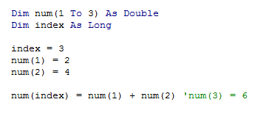
VBA Arrays
Array = vector or matrix
Dim num As Double ‘one number
Dim ArrayName (start to end) As Type
Need to have a parenthesis when referring to variables
This is 3 cells
Comment was added and is not necessary
VBA read this as num(3) = 2 + 4

Slide 18
VBA Arrays
Can create more than 1 dimension
Dim array(start1 to end1, start2 to end2, etc.) As Type
or
Dim array(end1, end2) As Type
variable with 121 rows & 3 columns
Option Base 1 ‘at top of module
Otherwise start1 and start2 default to 0
When Function has Variable-Sized Input or Output:
Option Base 1
Function A(Return As Range, Weights As Range) As Range
Dim A(),Return(),Weights()
R=Return.Rows.Count ‘ counts # of rows
C=Return.Columns.Count
Redim A(C,C),Return(R,C),Weights(R,C)
A = Application.MMult(Application.Transpose(Return),Weights)

Slide 19
Example: Covariance Matrix Function
Option Base 1
Function Covar_mat(returns As Range)
'returns are asset periodic returns in columns
Dim temp()
n = returns.Columns.Count 'number of assets
ReDim temp(n, n)
For i = 1 To n 'row counter
For j = 1 To n 'column counter
temp(i, j) = Application.Covar(returns.Columns(i),returns.Columns(j))
Next j
Next i
Covar_mat = temp ‘full temp matrix transferred to answer
End Function
from Lou Gattis
Could be done in 1 line?
.columns(i) is an object
allows calculations on an array
Nested Loop

Slide 20
For Next Loops
Loops allow you to easily repeat a task
For Var = Start to Stop Step N
For x= omega-1 to 0 Step -1 A(x) = v* q(x) + v*p(x)*A(x+1) Next x
Indent all lines between For & Next statements
Step is optional (default = 1)
Start & stop can be variables (advantage over Excel)
Do Loop While or Until (loop until get close answer)

Slide 21
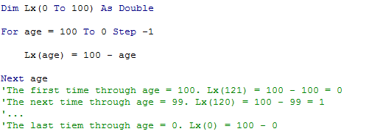
Loops-> For-Next Loops
Error. Sometimes 100 should be 121

Slide 22
If Statements
3-Way Nested If If condition Then
code
Else If condition Then
code
Else
code
End If
If condition Then
code
Else
code
End if
Can do in one line
If Num < 2 Then Num = 4 Else Num = 5
Works even though End If isn’t at end

Slide 23
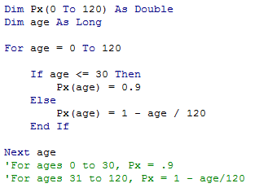
If statement Example

Slide 24
Communicating with Excel
VBA does NOT talk to Excel unless you tell it to
3 ways to Read info from cells in Excel
Qx=Sheets(“Sheet1”).Range(“A1”).Value
Qx=Sheets(“Sheet1”).Cells(row, column).Value
Big Advantage: row and column can be variables!
Row and column must be > 0
Radix=Range(“Radix”) ‘if radix is a named cell in Excel
‘You can also use Range(“Radix”) in an equation. It still entails going out to get it from Excel.
2 ways to Output results to Excel. Here’s one:
Sheets(“Sheet1”).Cells(row, column).Value=2*Qx
The word Value is not needed
If Sheets() excluded, it works in whatever sheet you are on. Not a good practice

Slide 25
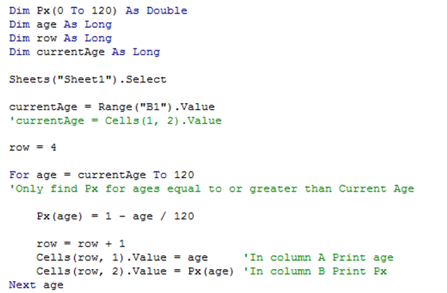
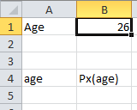
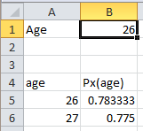
Communicating with Excel

Slide 26
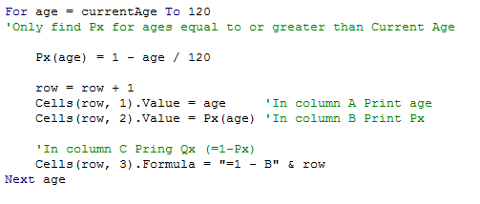
Communicating with Excel
Can also print formulas into Excel cells
Cells(row, col).formula = “=excel formula”
Range(“A1”).formula = “=excel formula”
Include the equal sign in the quotes too!

Slide 27
Tips on VBA (revised 11/11/2014)
There are things that you can do in VBA, which you can’t easily do in Excel. EG: variable amounts of output, not having to print every calculation, using IF THEN and FOR NEXT (loops), structured programming, etc. It makes it easier to do some things like Monte Carlo testing, working with matrices with variable indices, etc.
Getting Started: Open a VBA program in ANGEL. You may have to enable something at the top once or twice.
Hit Alt-F11 and double click on Module 1 in upper left box. Another VBA module may be in Module 2
The best way to learn is look at programs & see what they do. Then program HW. That’s 2nd best way to learn.
Load the VBA Add-In programs: Click on File>Options>Add-Ins. Then select VBA programs and hit OK
To write VBA programs with Developer (see later pages from Andrew Waldron for more details)
Click on File>Options>Customize Ribbon and click on Developer and hit ok
To create new program
Open new spreadsheet, hit Alt-F11, double click on Sheet1, type SUB program_name(), and start programming
To Record steps (good if you need to know how to write an Excel Function, e.g., Paste, clear, delete, select, etc):
Use Developer> Record Macro to record keystrokes/mouseclicks OR Google Excel VBA functions or buyVBA book
Worthless Modules? Right click on them, select Remove Module, and answer “No” to question
See sample programs (e.g., Appendix A of MQR) to learn VBA Syntax : Do you understand the following items in a program?
Dimension (Dim) and Comment statements (everything after an apostrophe ‘)
Equations, and writing formulas into cells, using R[1] C[0] or reference to variable names in spreadsheet
Assigning values to cells, which puts them into the spreadsheet
For Next statements (indent VBA statements inside loop)
If Then Else End If statements (indent VBA statements inside).
Application.WorksheetFunction.Ln to use LN function in Excel (or any other Excel function)
Functions (input & output can be a matrix: see example on right side of my sample VB program) & Subroutines
Thoroughly check ALL of your output frequently while programming!
To Debug see Andrew Waldron’s doc below. Hit F8 while in program, and keep hitting F8 as it moves thru the program.
If Debugger stops without providing a reason, check the variables in that line (or the prior or next one) to see that you don’t have an incorrect index (e.g., a negative, zero, or larger than the max index)
Make Long programs more Efficient
Type Application.Calculation = xlCalculationManual at beginning of program to turn off recalculation and Application.Calculation = xlCalculationAutomatic to turn it back on at end of program. If the macro ends prematurely, you will need to manually reset calculation to automatic in EXCEL.
If you need Excel to calculate something in the middle of the program use:
Calculate or Worksheets("sheet1").Calculate or Range("A1:C5").Calculate
Turn off screen updates at top with Application.ScreenUpdating = FALSE & turn back on at end with = TRUE
Minimize going into Excel using WorkSheets, Range, Cells, Select, and Application as much as possible (e.g., do them outside of loops). Replace Application.Min with: Max=A If B> A Then Max=B
Before SUB line insert the 2 words Option Explicit and dimension everything
Fewer loops is more efficient
Do the following, so that your data is read in all at one time, and printed out all at one time
Dim Q() As Variant
Q = Worksheets("qx data").Range("B3:B123").Value
For age = 0 To Omega - 1
qx(age,0) = Q(age+1, 1) ‘Must have 2 dimensions in order to read or print in batch
Next
Sheet1.Range(“D3:D123”)=qx
To see how long a program takes, use: Timestart = Timer ‘at beginning of program and Elapsed = Timer – Timestart ‘at end of program

Slide 28
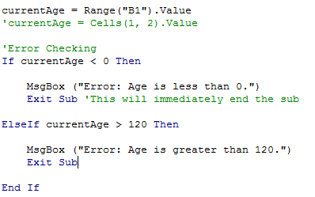
Error Checking
When you are receiving input, it is good to check for errors
E.G., input age not > than omega or < 0
See help on debugging in Excel/VBA tips!!!
E.G., use F8 to go thru line by line and hover over variables to see their values to find what’s wrong (or use Watch)

Slide 29
Common Functions
Rnd – Returns random number from 0 to 1
Round(var,2) - rounds to 2 decimals
Log(num) = Ln(num)
Exp(num) = e^num
Abs(num) = |num|
Application.WorksheetFunction.[excel func]
If type to 2nd dot, VBA provides excel functions
Use VBA functions when available
E.G., use Log(5) not Application.LN(5)
Going out to Excel wastes time
Write a separate function for MIN and Max, instead of using Application into Excel worksheet
See support.microsoft.com/kb/213660/EN-US/

Slide 30
Microsoft Excel Visual Basic Function
-------------------------------------------------------------------
ABS() Abs function
ATAN() Atn function
CHAR() CHR function (number of the character)
CODE() ASC function
COS() Cos function
DATE() DATESERIAL function (number for the date)
ERROR.TYPE() ERR function
EXACT() STRCOMP function (exactly the same?)
EXP() Exp function
INDIRECT() No equivalent - use Range, Cells, Offset, or any other way of referencing cells.
INFO() No equiv - use CURDIR function, the following Application properties (MEMORYTOTAL,
MEMORYUSED, MEMORYFREE, VERSION, OPERATINGSYSTEM, CALCULATION, COUNT)
ISBLANK() ISEMPTY function
ISREF() TYPENAME function
LEN() LEN function length of text
LOWER() LCASE function converts to lower case
N() No equivalent (none needed)
NA() No equivalent – use ActiveCell.Value = "#N/A"
RAND() RND function
RANDOMIZE() Randomize function
SIN() Sin function
SIGN() Sgn function
SQR() Sqr function
SQRT() Sqr function
T() No equivalant (none needed)
TAN() Tan function
Timer (time now)
TODAY() DATE function
TRUNC() FIX function (truncate)
TYPE() TYPENAME function
UPPER() UCASE function
VALUE() VAL function

Slide 31
Common Functions
Pop up message box
MsgBox(“Type what you want to display”)
Input Box
Var = InputBox(“Enter a value”)

Slide 32
Questions
Email me - abw5082@gmail.com
Google - search for Excel VBA and then your question or problem
Lynda.psu.edu

